Slide 1
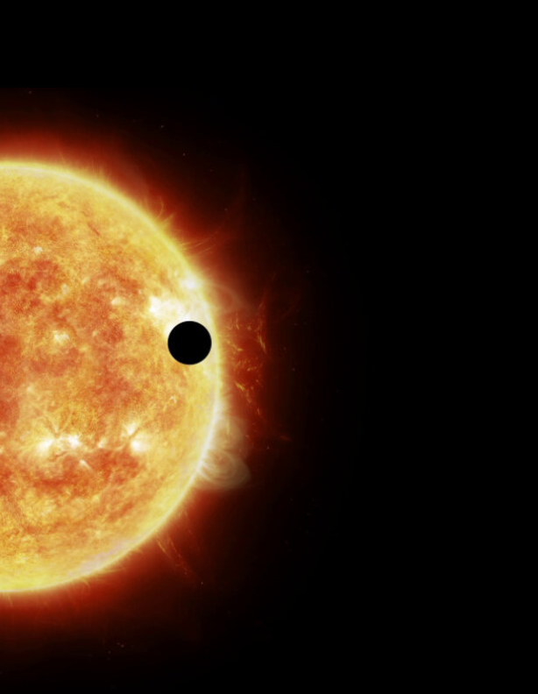
Machine Learning Approaches to the Detection of Exoplanet Transits
Anna Zuckerman, Leah Zuckerman, Ashutosh Gandhi, and Andrew Floyd
CSCI 4502/5502 Summer 2023

Slide 2
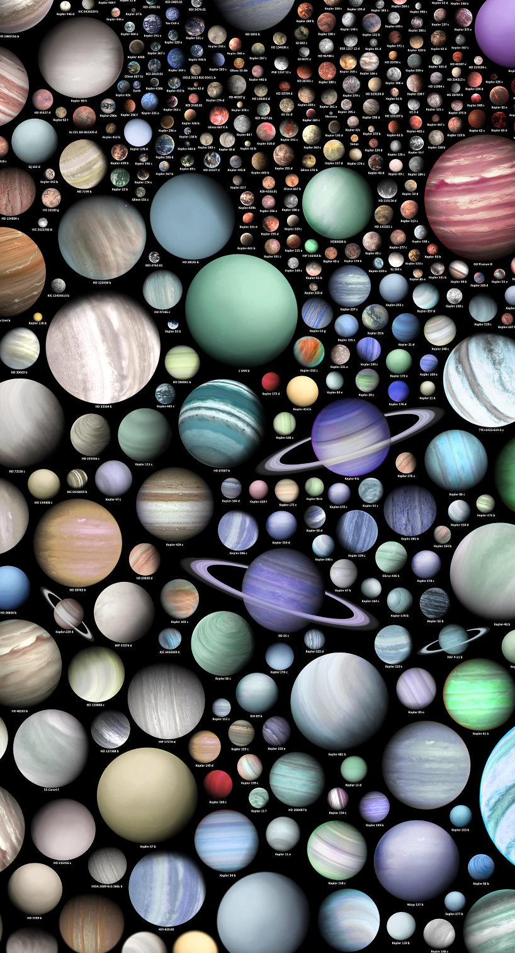
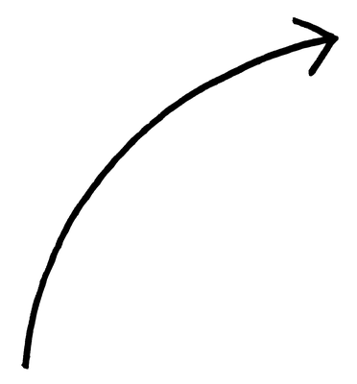
How can we find exoplanets?
Exoplanet = planet orbiting a star other than the sun
Only in science fiction until 1992!
Since then, thousands discovered
Artists representation!
Graphic: Martin Vargic

Slide 3
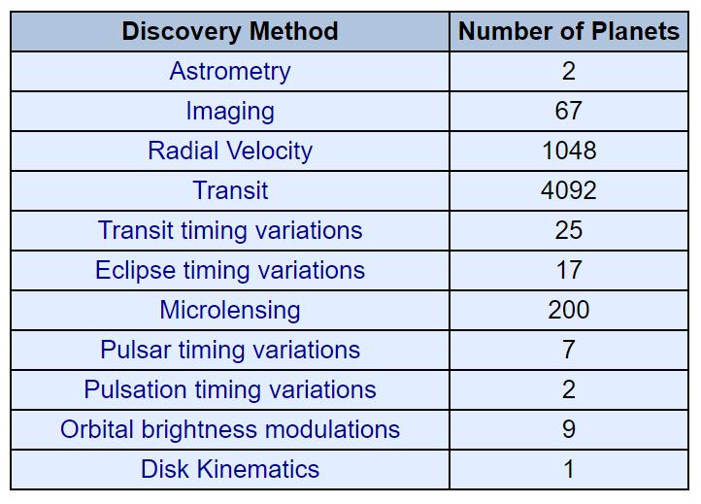
How can we find exoplanets?
Exoplanet = planet orbiting a star other than the sun
Only in science fiction until 1992!
Since then, thousands discovered
Graphic: Martin Vargic,Table: NExSci

Slide 4
How can we find exoplanets?
Exoplanet = planet orbiting a star other than the sun
Only in science fiction until 1992!
Since then, thousands discovered
Graphic: Martin Vargic,Table: NExSci

Slide 5
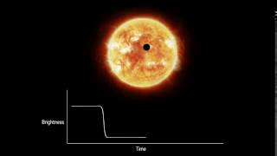
What are transits?
Animation: ESA

Slide 6
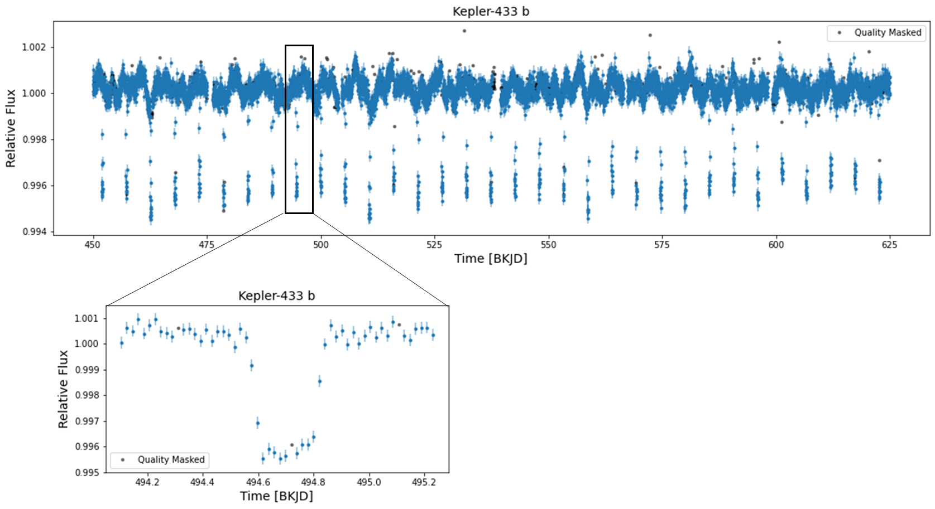
How can we use transits to detect new planets?
Inefficient to vet eye → Machine Learning

Slide 7
What has already been done?
Early 2000s: machine-aided approaches
Box-Fitting-Least-Squares (e.g. Kovacs et al., 2002)
Bayesian-based analysis of transit likelihood (Aigrain and Favata, 2002)
Mid-2010s: First widespread use of ML for transit detection (DTs, RFs, SVMs, KNNs)
Time and frequency domain data
Mostly used for “vetting” of “pre-triaged” observations.
Late 2010s: Application of Deep Learning algorithms
Largely for vetting
1D-convolutional networks (e.g. Zucker and Giryes, 2018)
Use with phase-folded curves (e.g. Pearson et al., 2018)
Our Task: ML classification of lightcurves without previous vetting.

Slide 8
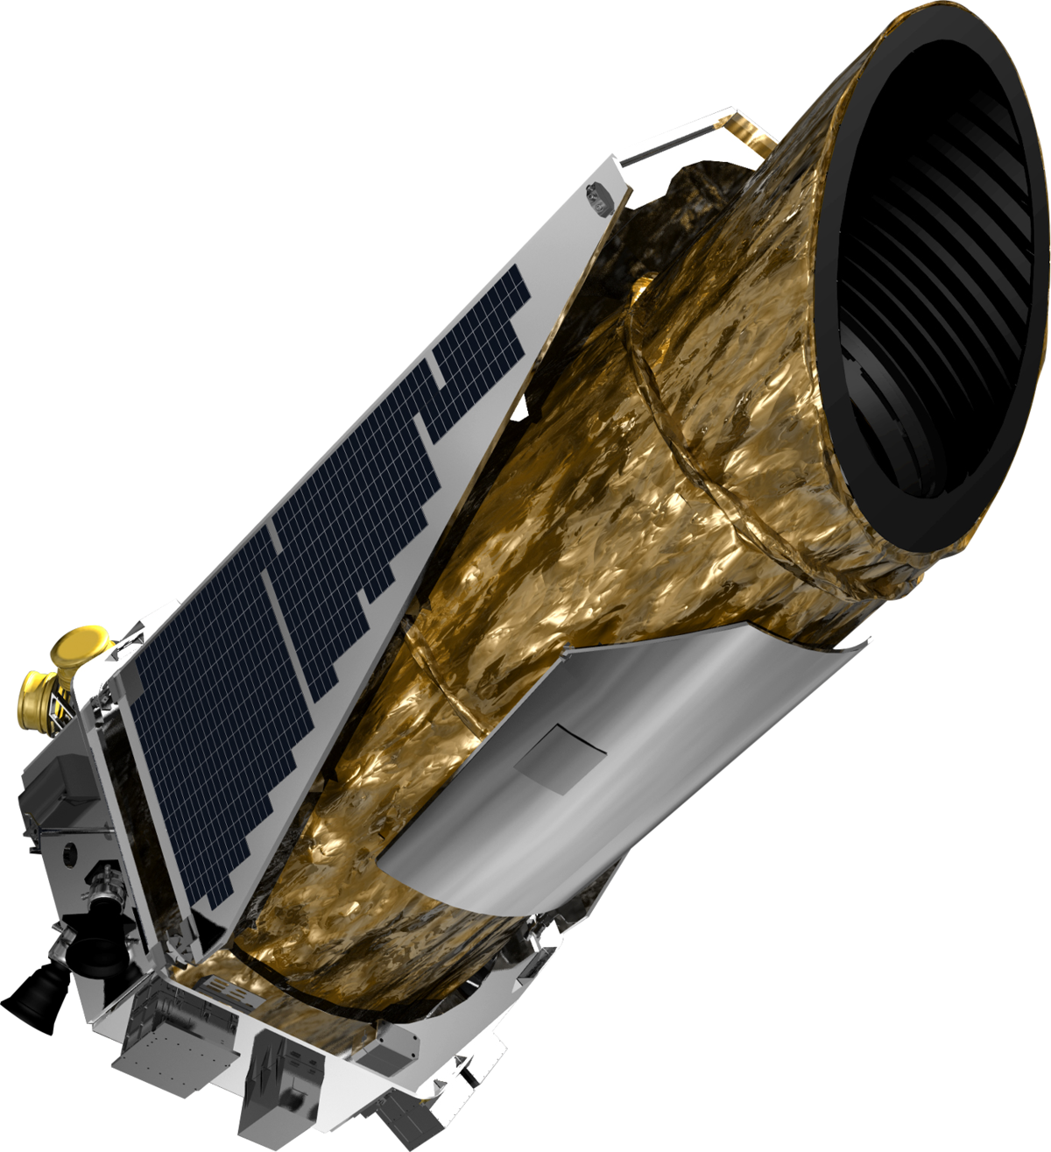
Data
Kepler mission is one of the largest exoplanet surveys (2708 confirmed detections)
High exposure time → able to observe dimmer, more distant targets
Prioritized Main Sequence stars for which Earth-like planets would be detectable
Thousands of lightcurves of stellar targets, some with transiting exoplanets
Lightcurves are publicly available online
NASA Exoplanet Archive for class labels
Lightcurve data:
Several 90-day quarters, at a cadence of 30min
Flux (light intensity) as a function of time from each target star
Intervals of missing data due to telescope operation, and many quality flagged datapoints.
The Kepler satellite

Slide 9
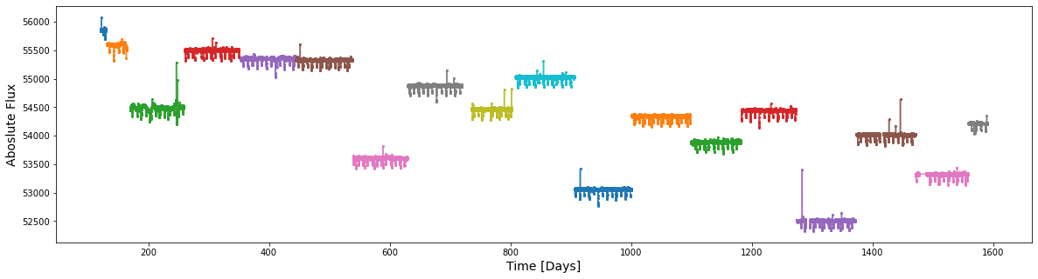
Preprocessing
Preprocessing steps:
1
Fit and remove quarterly linear trends
2
Stitch quarters

Slide 10
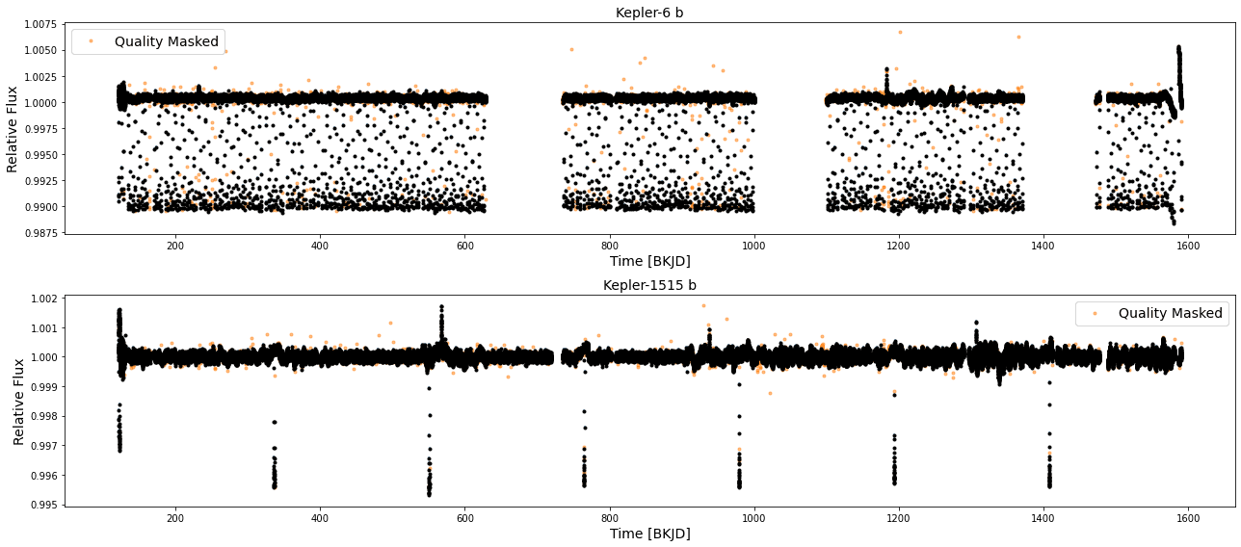
Preprocessing
Preprocessing steps:
1
Fit and remove quarterly linear trends
2
Stitch quarters
3
Mask data flagged for quality issues
​
​
​

Slide 11
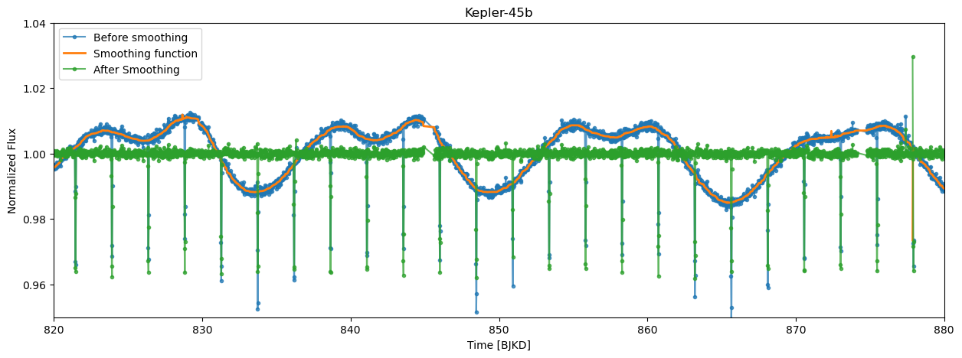
Preprocessing
Preprocessing steps:
1
Fit and remove quarterly linear trends
2
Stitch quarters
3
Mask data flagged for quality issues
4
Remove stellar variability by smoothing

Slide 12
Preprocessing
Preprocessing steps:
1
Fit and remove quarterly linear trends
2
Stitch quarters
3
Mask data flagged for quality issues
4
Remove stellar variability by smoothing
5
Fill in missing values by interpolation

Slide 13
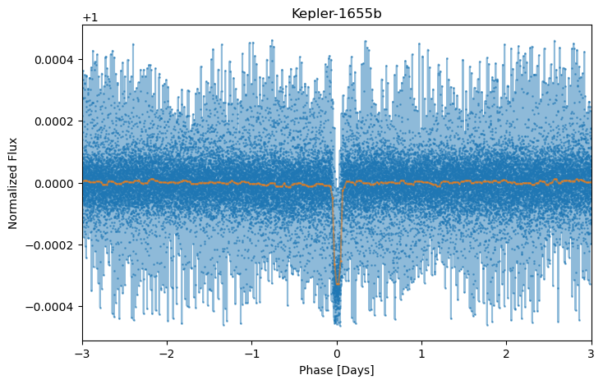
Feature Engineering
First, we ran our classification algorithms on “raw” lightcurves
Features → flux values at each timestep
But, feature comparison between lightcurves this way is not meaningful
Many algorithms compare “distance” or create decision boundaries based on the same feature for each observation.
Solution: phase folding
Create boxed-least-squares periodogram
Fold on period of maximum power
Bin to reduce noise and construct equal length observations
Also explored Recursive feature selection (RFE) and SelectKBest
feature selection not very meaningful for our data
Notes:
We first tried running our algr

Slide 14
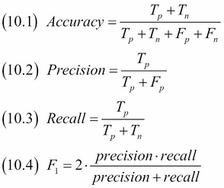
Model selection
For the selection of model we considered the following classification metrics:
Accuracy: ratio of correctly classified instances to the total number of instances.
Recall: ratio of true positives to the sum of true positives and false positives
Precision: ratio of true positives to the sum of true positives and false negative
F1-score: harmonic mean of recall and precision
Among the 4 we decided to evaluate all the models based on the F1-score.
Notes:
For the selection of model we considered the following classification metrics:
• Accuracy: Accuracy is the most straightforward metric and measures the overall correctness of the predictions by calculating the ratio of correctly classified instances to the total number of instances.
• Precision: Precision calculates the ratio of true positives (correctly predicted positive instances) to the sum of true positives and false positives (incorrectly predicted positive instances). It indicates how many of the predicted positive instances are actually relevant.
• Recall (Sensitivity or True Positive Rate): Recall calculates the ratio of true positives to the sum of true positives and false negatives (missed positive instances). It indicates the proportion of actual positive instances that are correctly identified.
• F1 Score: The F1 score is the harmonic mean of precision and recall. It provides a single metric that balances both precision and recall.
Among the 4 we decided to evaluate all the models based on the F1-score. For our dataset, accuracy alone will be inadequate due to the imbalanced nature of the data. The data typically has a larger number of light curves without any transit signal compared to those with true transits. Instead we consider the recall and precision values, because in our case,
it is preferable to accept a higher number of false positives (incorrectly identified planet candidates) rather than missing potential planet signals. So we selected F1-score as the metric for model selection which combines both precision and recall into a single metric. The hyperparameter tuning evaluation is done based on accuracy on the validation data and model selection is based on the F1-score on the test data.

Slide 15
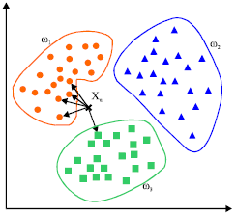
Algorithms: KNN
Motivation: baseline to compare to other classification methods.
The KNN algorithm:
Store training data as points in feature space.
Find the k nearest neighbors to each new observation using a pre-defined distance metric (we use Euclidean)
Because of the nature of our observations, future work could define a more meaningful metric
Take the mode of the labels of the k neighbors to predict the label of the new
KNN is considered a “lazy learner” because training involves merely storing the training data
Does not produce a true “model” that one can examine to gain insight into our data
Image: medium.com

Slide 16
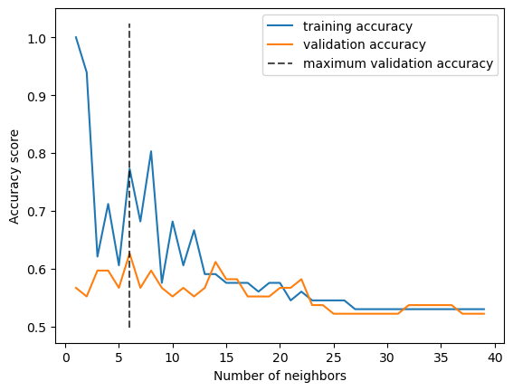
Algorithms: KNN
Results on Non-Engineered Features
Tuning hyperparameter k:
Best validation results for k=6

Slide 17
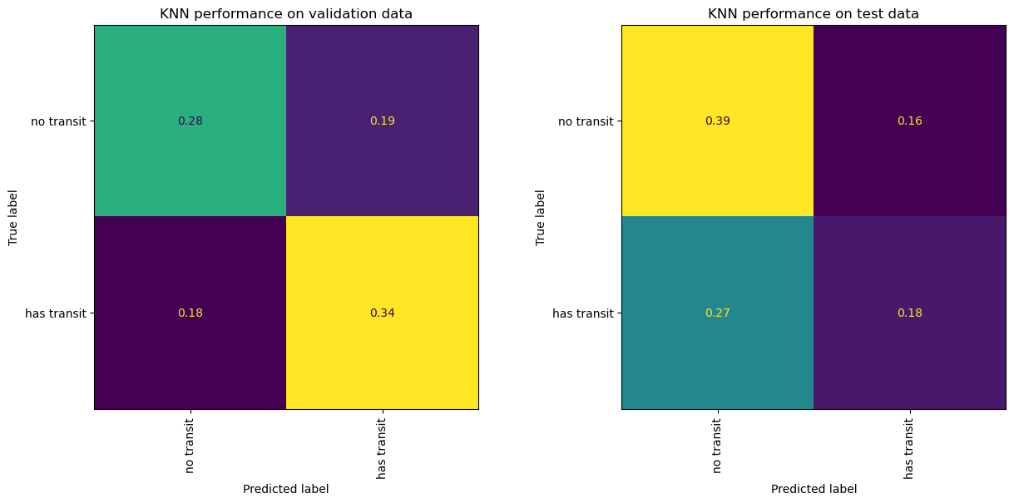
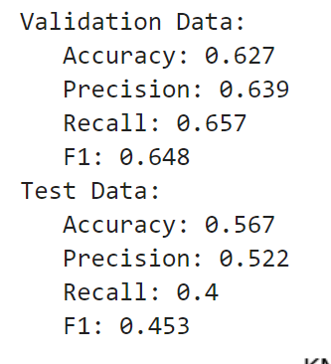
Algorithms: KNN
Results on Non-Engineered Features
Tuning hyperparameter k:
Best validation results for k=6
Performance:
Notes:
When go to test data loses the nice bias to positive observations that it had on the validation data

Slide 18
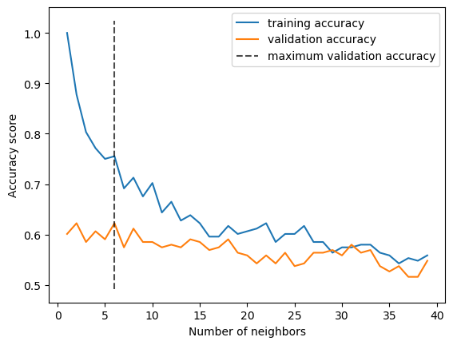
Algorithms: KNN
Results on Engineered Features
Tuning hyperparameter k:
Best validation results for k=6
Notes:
Engineered = phase-folded

Slide 19
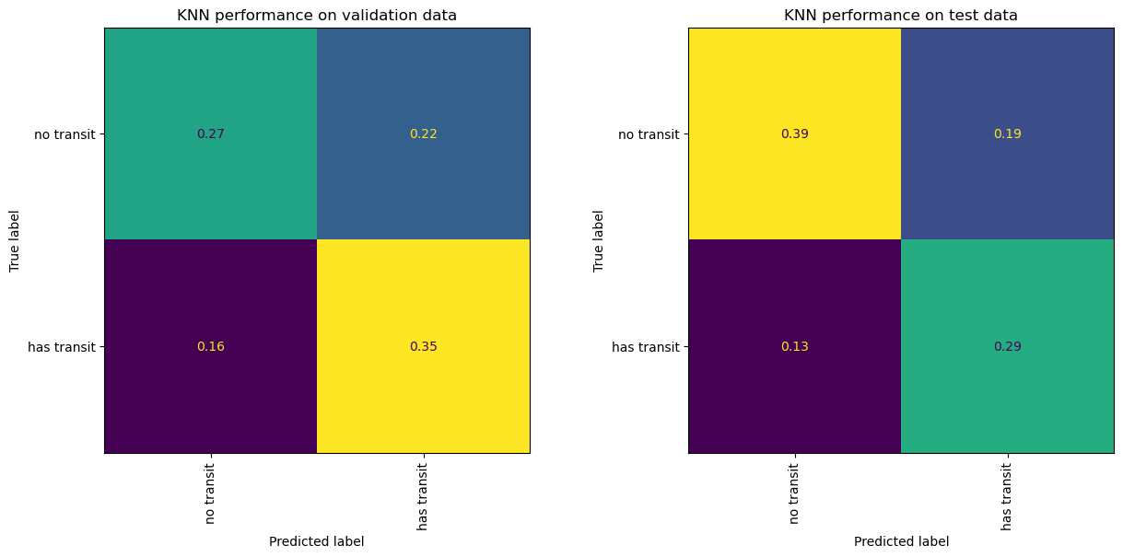
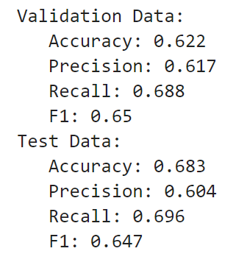
Algorithms: KNN
Results on Engineered Features
Tuning hyperparameter k:
Best validation results for k=6
Performance:
Notes:
Better about keeping the nice bias to positive observations that it had on the validation data

Slide 20
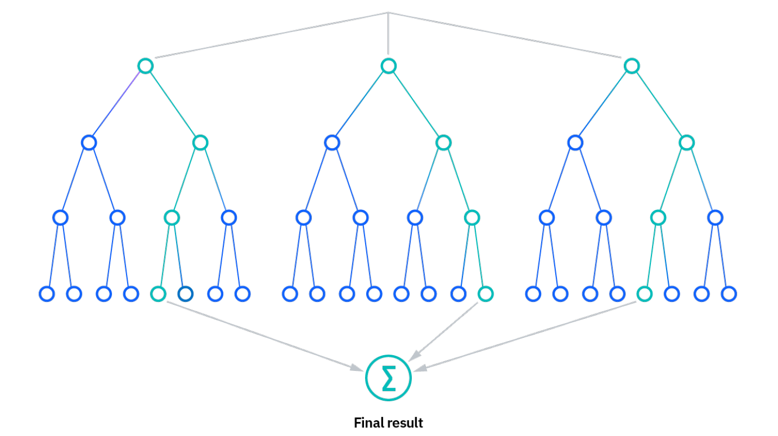
Algorithms: Random Forest
Motivation: less prone to overfitting, good for high-dimensional data
The Random Forest algorithm: collection of Decision Tree (DT) classifiers, each trained on subsamples of the data
For each DT
Construct a subset of training data
Iteratively determine splits at each node based on some metric
We choose information gain
Stop once all nodes contain only one class
Prune to reduce overfitting
We set a maximum tree depth, but we still overfit
Label new observations with the mode of training labels in
the reached leaf node
Classification is assigned using the majority vote.
Initially, find a bias to misclassify observations as negative rather than as positive.
Based on science case, prefer the opposite
Add a set of class weights to encourage positive classifications
Image: IBM

Slide 21
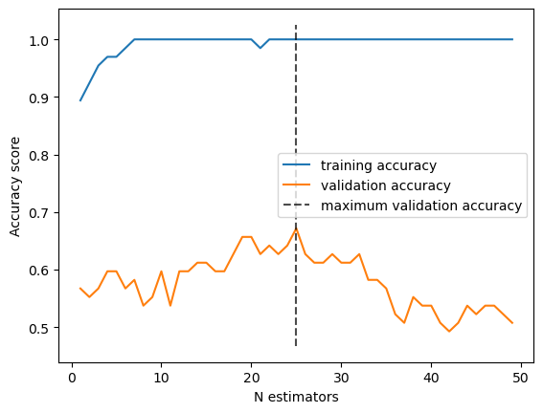
Algorithms: Random Forest
Results on Non-Engineered Features
Tuning hyperparameter n_estimators (number of classifiers):
Best validation results for n_estimators = 25

Slide 22

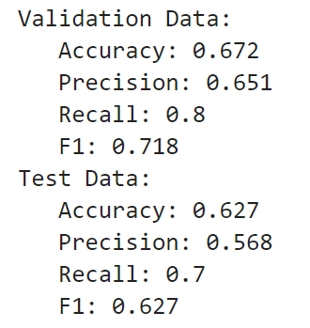
Algorithms: Random Forest
Results on Non-Engineered Features
Tuning hyperparameter n_estimators (number of classifiers):
Best validation results for n_estimators = 25
Performance:
Notes:
Overfitting, as shown by much better training performance

Slide 23
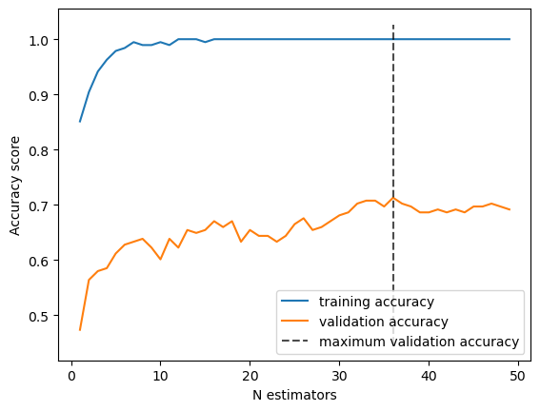
Algorithms: Random Forest
Results on Engineered Features
Tuning hyperparameter n_estimators (number of classifiers):
Best validation results for n_estimators = 36

Slide 24
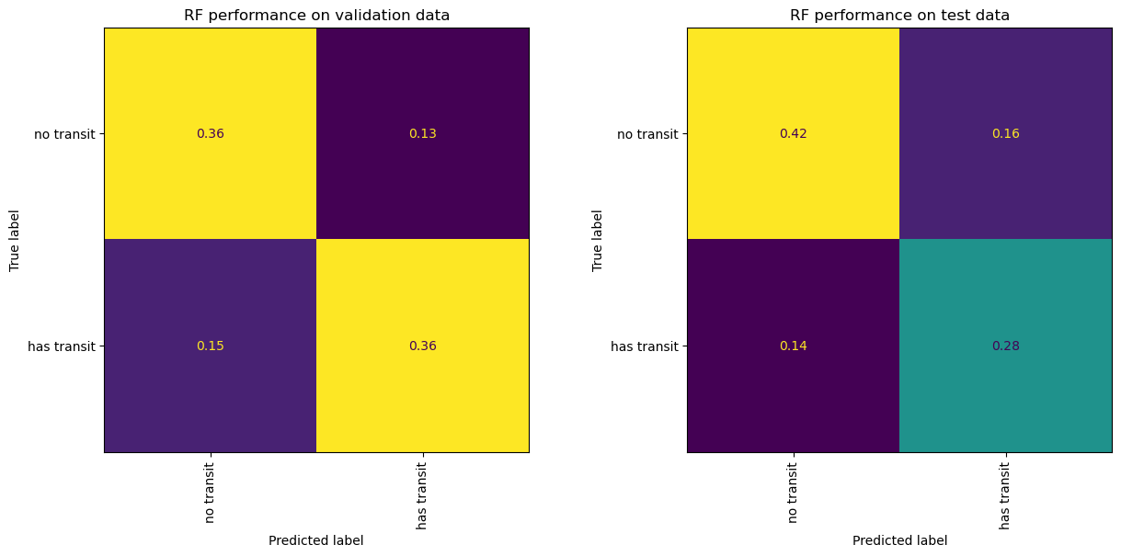
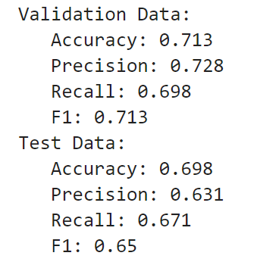
Algorithms: Random Forest
Results on Engineered Features
Tuning hyperparameter n_estimators (number of classifiers):
Best validation results for n_estimators = 36
Performance:

Slide 25
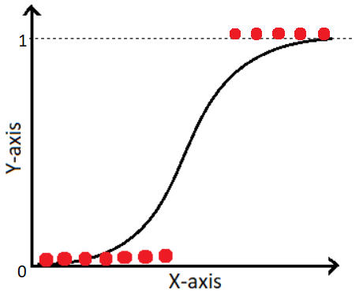
Algorithms: Weighted Logistic Regression
The Logistic Regression algorithm:
Construct a decision boundary in feature space by finding the logistic function that best splits the data by class label.
Best-split is determined by minimizing the log-loss of the predicted and true values
Can return likelihoods; we use a classification threshold of 0.5.
We were unable to achieve good performance
Model either classified all observations as positive or all observations as negative each time
Can’t closely fit our decision boundary
Add class weights to encourage the model to make both positive and negative classifications
Highly sensitive to class weights near critical value
Image: medium.com

Slide 26
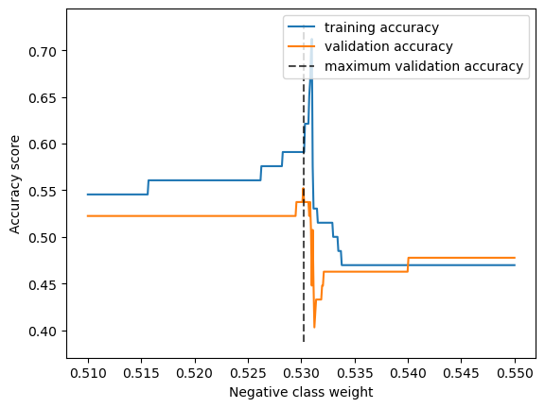
Algorithms: Logistic Regression
Results on Non-Engineered Features
Tuning hyperparameter class weights (positive weight = 1 - negative weight):
Best validation results for negative weight = 0.5302004
Notes:
Reallt sensitive to exact weight values!

Slide 27
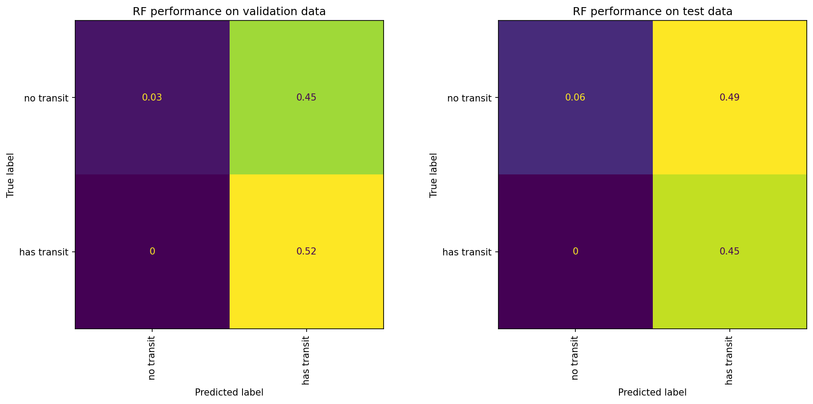
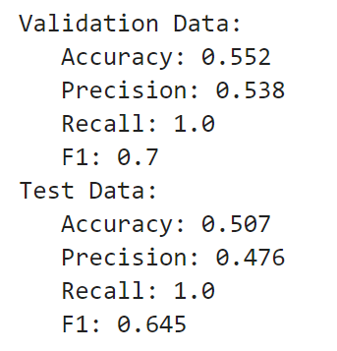
Algorithms: Logistic Regression
Results on Non-Engineered Features
Tuning hyperparameter class weights (positive weight = 1 - negative weight):
Best validation results for negative weight = 0.5302004
Performance:
Notes:
Still really bad results!

Slide 28
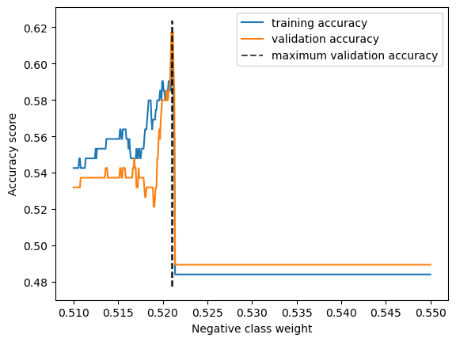
Algorithms: Logistic Regression
Results on Engineered Features
Tuning hyperparameter class weights (positive weight = 1 - negative weight):
Best validation results for negative weight = 0.52098196

Slide 29
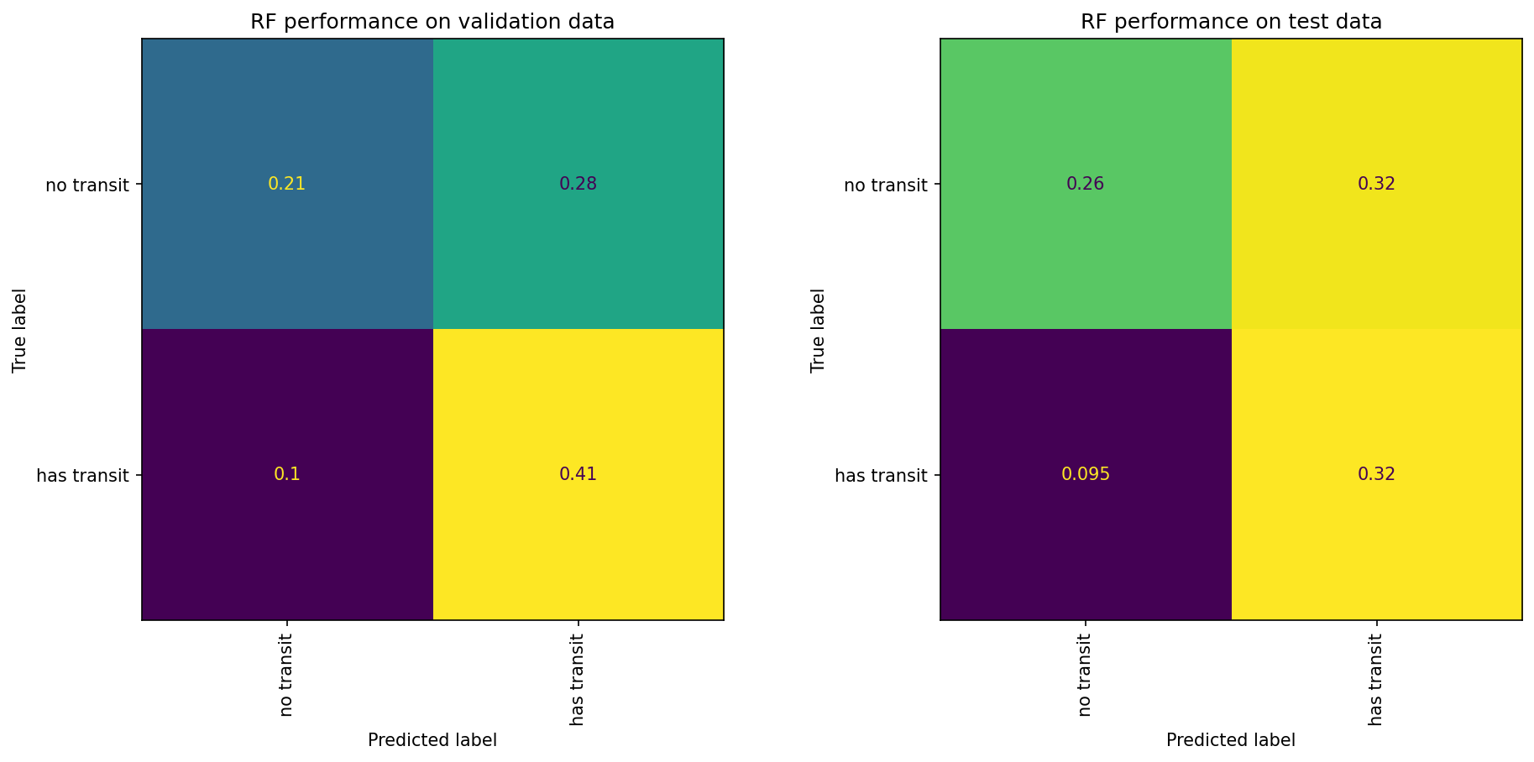
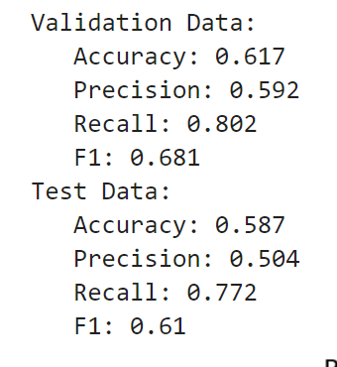
Algorithms: Logistic Regression
Results on Engineered Features
Tuning hyperparameter class weights (positive weight = 1 - negative weight):
Best validation results for negative weight = 0.52098196
Performance:

Slide 30
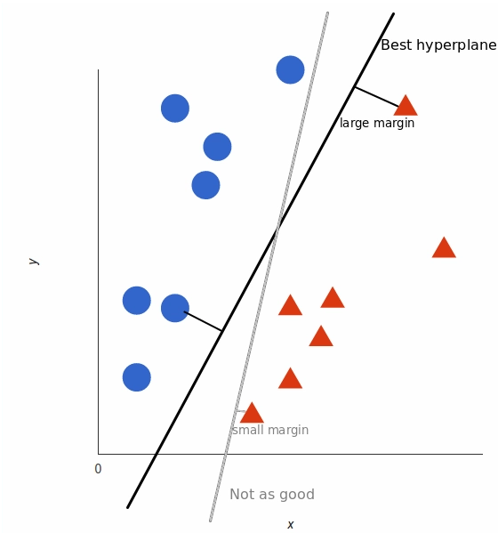
Algorithms: SVM
Motivation: SVMs are efficient in managing high-dimensional data and identifying non-linear relationships.
The SVM Algorithm: find the optimal hyperplane in an N-dimensional space that can separate the data points in different classes
Identify the support vectors, which are the data points closed to the decision hyperplane.
Maximize the distance between the support vectors and the hyperplane while minimizing the classification errors.
In case of non-linear kernel, the input data is implicitly transformed into higher dimensional feature space by the kernel function.
The final prediction is based on the decision function that is calculated using the weights (hyperplane equation) learned during training and a bias term. If the sign of the decision function value is positive then predict the positive label otherwise the negative label.
Image source: Monkey Learn
Notes:
The motivation behind trying out the Support Vector Machine(SVM) model was the advantage SVM provides in efficiently managing high-dimensional data and in identifying non-linear relationships among the data.
The main objective of the SVM algorithm is to find the optimal hyperplane in an N-dimensional space that can separate the data points in different classes of the feature space. The model tries to keep the margin between the hyperplane and its closest points of different classes as maximum as possible. The points that are closest to this hyperplane are called the support vectors. In Case of non-linear kernel, the input data is implicitly transformed into higher dimensional feature space by the kernel function.
The final prediction is based on the decision function that is calculated using the weights(hyperplane equation) learned during training and a bias term. If the sign of the decision function value is positive then predict the positive label otherwise the negative label. Since prediction of the label is solely based on these support vectors and hence this model is very memory efficient
The diagram below shows an example of of the hyperplane that SVM creates. It would find a plane that would have the largest possible margin to it’s support vectors. As can be seen in the diagram the solid line is the optimal plane whereas the light line is an suboptimal plane because the margin to it’s support vector is small.

Slide 31
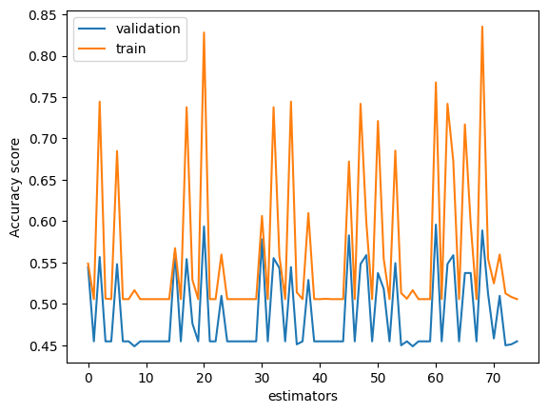
Algorithms: SVM
Results on Non-Engineered Features
Tuning hyperparameter C (regularization param), gamma (Kernel coefficient), kernel:
Best validation results for C=1000, gamma=1, and kernel=rbf (radial basis function)
Notes:
The best result for the SVM model was achieved on the raw data and not the phase-fold feature engineered data. We tuned the model based on three hyperparameter values - C (the regularization coefficient), gamma - The kernel coefficient and kernel type as either of radial basis function(rbf), sigmoid and polynomial. The dataset was split into a train/test ratio of 80/20 and k-fold cross validation with k=10 was performed on the training data. The graph below shows the train and validation accuracy achieved for each of the 50 permutations amongst the hyperparameters. The best validation accuracy of 76% was achieved with the hyperparameter values of C=1000, gamma=1 and kernel as radial basis function.

Slide 32
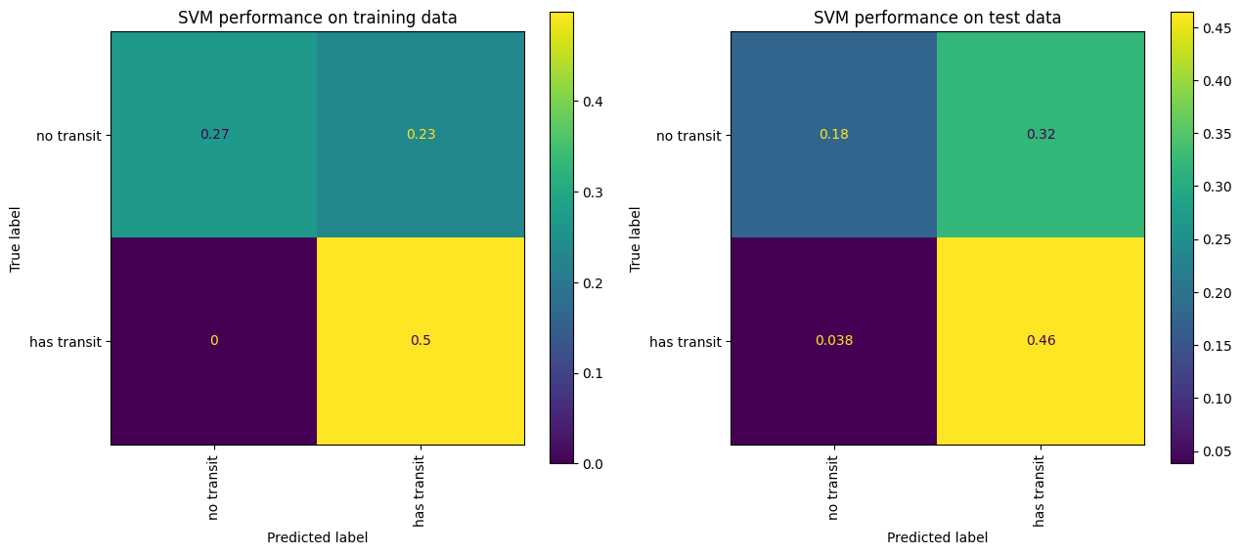
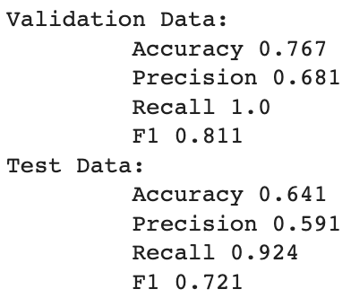
Algorithms: SVM
Results on Non-Engineered Features
Tuning hyperparameter C (regularization param), gamma (Kernel coefficient), kernel:
Best validation results for C=1000, gamma=1, and kernel=rbf (radial basis function)
Performance:
Notes:
Based on the hyperparameters identified in the training step, an test accuracy of 64% was achieved with an f1-score of 0.72. The confusion matrix along with the other performance metrics for both training/validation and test are shown below. Although the recall score was at on the higher side at 93%, the model was not selected as the best model because of the low precision score. The high recall score was because most of the predictions were made for the positive label only and the precision score was much poorer in comparison to the other models.

Slide 33
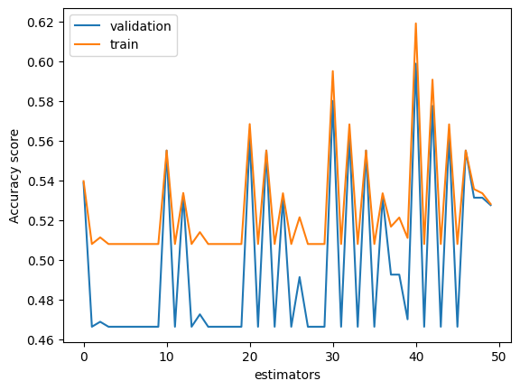
Algorithms: SVM
Results on Engineered Features
Tuning hyperparameter C (regularization param), gamma (Kernel coefficient), kernel:
Best validation results for C=1000, gamma=1, and kernel=rbf (radial basis function)
Notes:
The best result for the SVM model was achieved on the feature engineered phase-folded data. We tune the model based on three hyperparameter values - C (the regularization coefficient), gamma - The kernel coefficient and kernel type as either of radial basis function(rbf), sigmoid and polynomial. The dataset was split into a train/test ratio of 80/20 and k-fold cross validation was performed on the train data. The graph below shows the train and validation accuracy achieved for each of the 50 permutations amongst the hyperparameters. The best validation accuracy of 62% was achieved with the hyperparameter values of C=1000, gamma=1 and kernel as radial basis function.

Slide 34
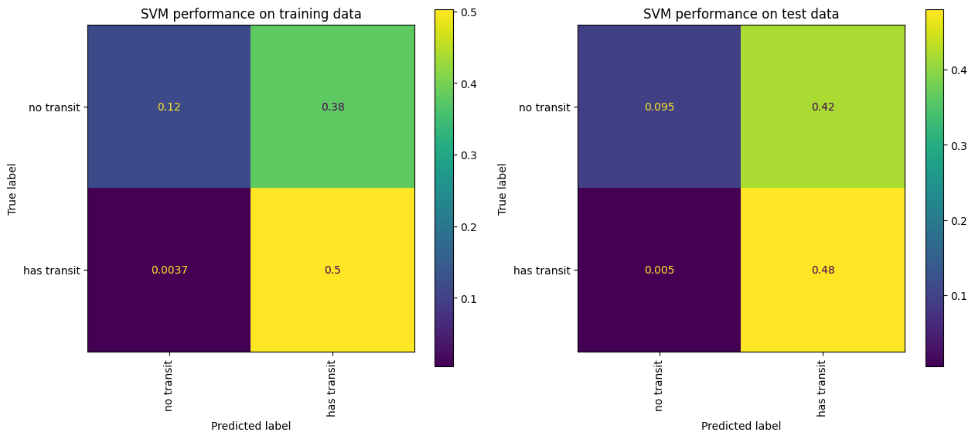
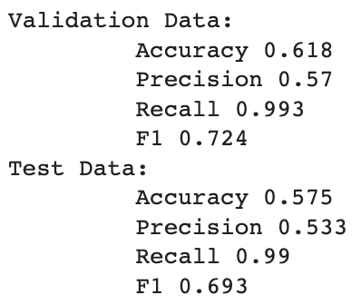
Algorithms: SVM
Results on Engineered Features
Tuning hyperparameter C (regularization param), gamma (Kernel coefficient), kernel:
Best validation results for C=1000, gamma=1, and kernel=rbf (radial basis function)
Performance:
Notes:
Based on the hyperparameters identified in the training step, an test accuracy of 57.5% was achieved with an f1-score of 0.7. The confusion matrix along with the other performance metrics for both training/validation and test are shown below. Although the recall score was close to 100%, the model was not selected as the best model because of the low precision score. The high recall score was because most of the predictions were made for the positive label only and the precision score was much poorer in comparison to the other models.

Slide 35
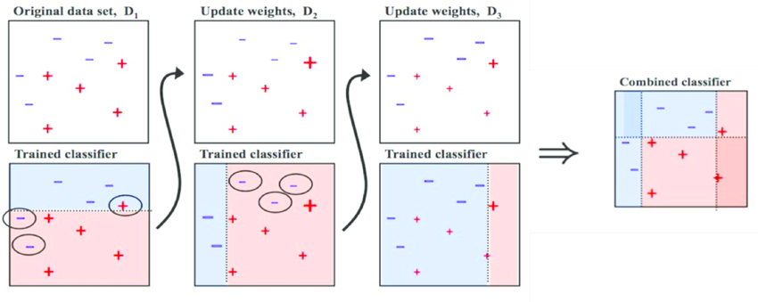
Algorithms: AdaBoost
The AdaBoost Algorithm: collection of Decision Tree (DT) classifiers, improving on each iteration through weighted voting
Initialization of weights. Normally consider 1/n_samples
Train an estimator using current weights
Calculate the error_rate based on the prediction of the estimator
Update the weights using the learning rate and error_rate.
Repeat the steps 2-4 for n estimators
Final prediction is assigned as the weighted sum of all the DT after all the iterations are done.
Image source: towardsdatascience
Notes:
AdaBoost applies the Boosting ensemble technique. It attempts to build a strong classifier from a number of weak classifiers. It is a collection of Decision Tree (DT) classifiers, improving on each iteration through weighted voting
Initially, all weights are set to a default constant (usually 1/number of samples), leading to the first step where a weak learner is trained on the original data. In each subsequent iteration, the sample weights are adjusted. At each step, the samples that were incorrectly predicted by the boosted model in the previous iteration have their weights increased, while the weights are decreased for those samples that were predicted correctly. These steps are repeated for n estimators.
The predictions from these learners are then combined using a weighted majority vote (or sum) to arrive at the final prediction.
The diagram below shows 3 iterations of the algorithm. In the first iteration a simple model is trained and the data points which are incorrectly predicted have there weights increased and the correctly predicted ones weights decreased. With this new increased weight the next model would be more sensitive to the errors made in the previous iteration. The same process is repeated one more time and finally a combined prediction is made.

Slide 36
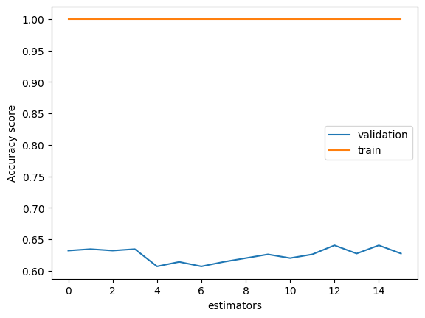
Algorithms: AdaBoost
Results on Non-Engineered Features
Tuning hyperparameter max_depth and min_samples_leaf for base estimator along with learning_rate and n_estimators:
Best validation results for base_estimator__max_depth=20, base_estimator__min_samples_leaf=7, learning_rate=0.01, n_estimators=60

Slide 37
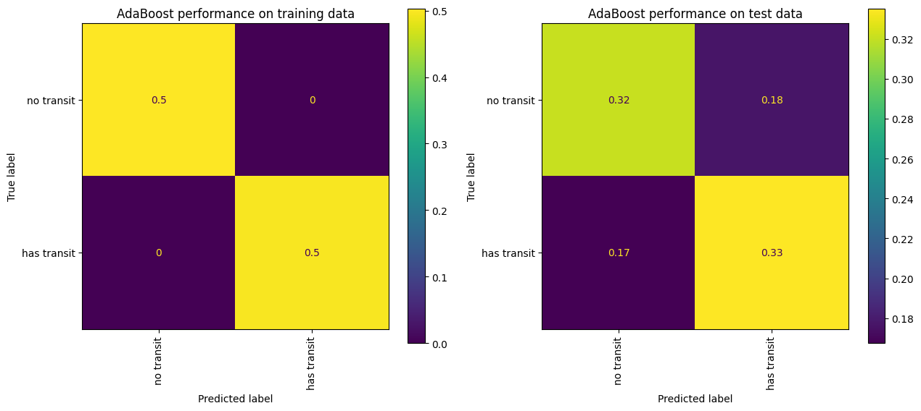
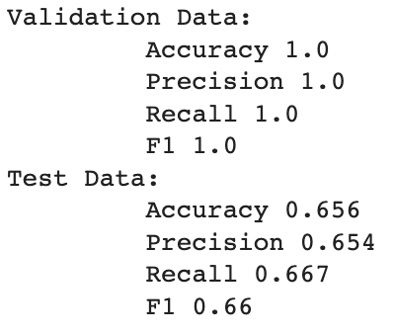
Algorithms: AdaBoost
Results on Non-Engineered Features
Tuning hyperparameter max_depth and min_samples_leaf for base estimator along with learning_rate and n_estimators:
Best validation results for base_estimator__max_depth=20, base_estimator__min_samples_leaf=7, learning_rate=0.01, n_estimators=60
Performance:

Slide 38
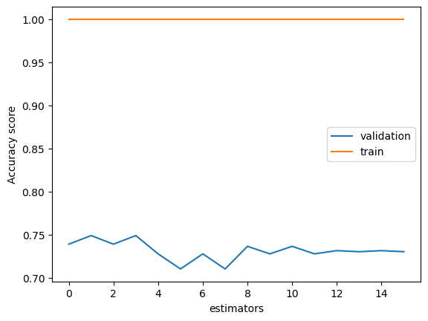
Algorithms: AdaBoost
Results on Engineered Features
Tuning hyperparameter max_depth and min_samples_leaf for base estimator along with learning_rate and n_estimators:
Best validation results for base_estimator__max_depth=20, base_estimator__min_samples_leaf=7, learning_rate=0.01, n_estimators=60
Notes:
The best result for the AdaBoost model was achieved on the phase-fold feature engineered data. We tuned the model based on 2 hyperparameter values - max_depth, min_samples_leaf of the base estimator along with learning_rate and n_estimators. The best validation accuracy of 75% was achieved with the hyperparameter values of as shown in the slide.
The best result for the AdaBoost model was achieved on the phase-fold feature engineered data. We tuned the model based on 2 hyperparameter values - max_depth, min_samples_leaf of the base estimator along with learning_rate and n_estimators. The max depth and min samples leaf are to ensure that the model is not overfitted and these parameters help prune the tree. n_estimators is the maximum number of estimators at which boosting is terminated and the learning rate indicates the weight applied to each classifier at each boosting iteration. The dataset was split into a train/test ratio of 80/20 and k-fold cross validation with k=10 was performed on the training data. The graph below shows the train and validation accuracy achieved for each of the 16 permutations amongst the hyperparameters. The best validation accuracy of 75% was achieved with the hyperparameter values of max_depth=20, min_samples_leaf=7, learning_rate=0.01, n_estimators=60.
.

Slide 39
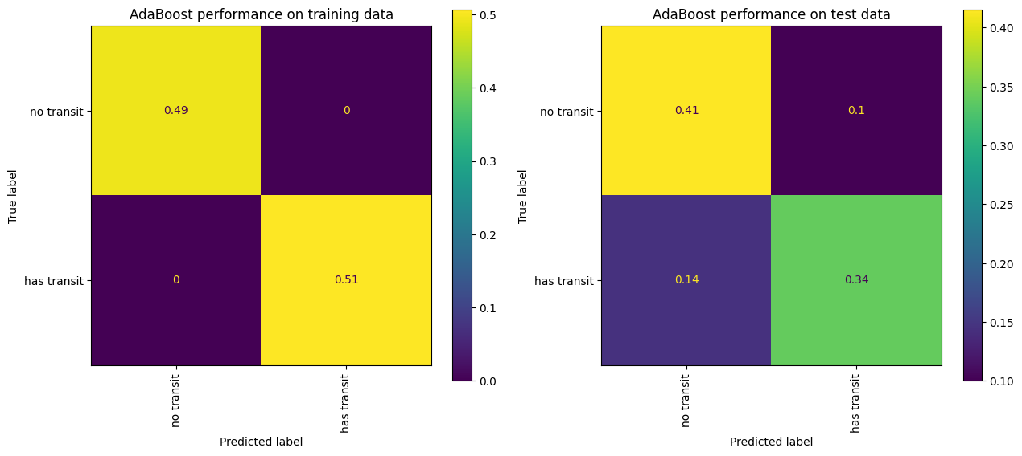
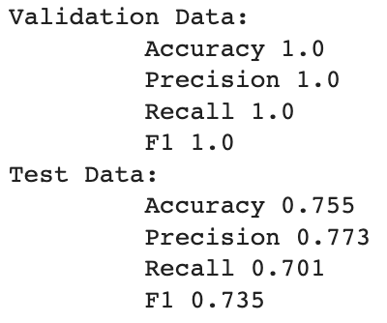
Algorithms: AdaBoost
Results on Engineered Features
Tuning hyperparameter max_depth and min_samples_leaf for base estimator along with learning_rate and n_estimators:
Best validation results for base_estimator__max_depth=10, base_estimator__min_samples_leaf=5, learning_rate=0.01, n_estimators=70
Performance:
Notes:
Based on the hyperparameters identified in the training step, an test accuracy of 75.5% and a F1-score of 73.5%.
The confusion matrix along with the other performance metrics for both training/validation and test are shown below. The model provided a good trade-off between precision and recall with a f1-score of 0.74 on the test data.

Slide 40
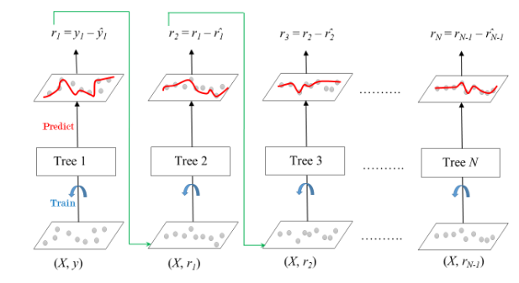
Algorithms: Gradient Boost
The Gradient Boost Algorithm: collection of Decision Tree (DT) classifiers, improving on each iteration by correcting the errors of its predecessors
Initialization: create a simple model of DT as the first weak learner.
Calculate the error_rate/residual based on the prediction of the estimator
Iteratively build weak learners by reducing the residual error, and correcting the mistakes of the previous model. This is controlled by the learning rate.
Next the ensemble prediction is updated as the weighted sum of predictions from new learner and the previous ones.
Repeat the steps 2-4 for n estimators
Final prediction is assigned as the weighted sum of all the DT after all the iterations are done.
Image source: geeksforgeeks
Notes:
Gradient Boost applies the same Boosting principles as that of AdaBoost. It builds a collection of Decision Tree (DT) classifiers, improving on each iteration by correcting the errors of its predecessors.
The Algorithm works in the following steps:
1. Initialization: The process begins by creating a simple model, usually a decision tree as the first weak learner.
2. Residual Calculation: The next step involves calculating the residuals, which are the differences between the actual target values and the predictions made by the first weak learner.
3. Building Weak Learners Iteratively: In each iteration, a new weak learner (decision tree) is built to predict the residuals from the previous step, not the original target values. The new weak learner is trained to minimize the residual error, thus correcting the mistakes of the previous model.
4. Updating the Ensemble: The predictions of the new weak learner are combined with the predictions from the previous models using a weighted sum or a weighted majority vote.
5.Iterative Process: The above steps are repeated for a predefined number of iterations or until a specified performance threshold is reached.
Final Prediction: The final prediction of the Gradient Boosting Classifier is the summation of predictions made by all weak learners, taking into account the learning rate and their individual weights.
Gradient Boost applies the same Boosting principles as that of AdaBoost. It builds a collection of Decision Tree (DT) classifiers, improving on each iteration by correcting the errors of its predecessors.
The Algorithm works in the following steps:
1. Initialization: The process begins by creating a simple model, usually a decision tree as the first weak learner. The initial model predicts the target
variable but is often inaccurate since it’s too simplistic.
2. Residual Calculation: The next step involves calculating the residuals, which are the differences between the actual target values and the predictions made by the first weak learner. These residuals represent the errors that the first model couldn’t capture.
3. Building Weak Learners Iteratively: In each iteration, a new weak learner (decision tree) is built to predict the residuals from the previous step, not the original target values. The new weak learner is trained to minimize the residual error, thus correcting the mistakes of the previous model. The learning rate is applied to the predictions of each weak learner, controlling the contribution of each model to the final ensemble.
4. Updating the Ensemble: The predictions of the new weak learner are combined with the predictions from the previous models using a weighted sum or a weighted majority vote. The combined predictions represent an improved estimate of the target variable compared to the previous iterations.
5.Iterative Process: The above steps are repeated for a predefined number of iterations or until a specified performance threshold is reached.
Final Prediction: The final prediction of the Gradient Boosting Classifier is the summation of predictions made by all weak learners, taking into account the learning rate and their individual weights.
The diagram below show how each iteration of the algorithm runs. We start with Tree1 that is trained using the feature matrix X and the labels y. The predictions labeled y1(hat) are used to determine the training set residual errors r1. Tree2 is then trained using the feature matrix X and the residual errors r1 of Tree1 as labels. The predicted results r1(hat) are then used to determine the residual r2. The process is repeated until all the n_estimator trees forming the ensemble are trained.
The main difference between AdaBoost and Gradient Boost is the optimization objective. AdaBoost aims to minimize the weighted error, where the weights are associated with data points. On the other hand, Gradient Boosting aims to minimize the residuals of the previous model, making each new weak learner correct the mistakes made by the ensemble built so far.

Slide 41
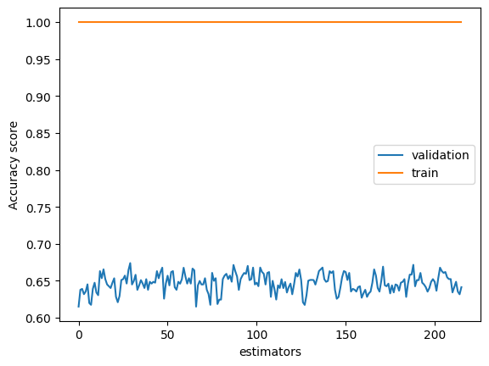
Algorithms: Gradient Boost
Results on Non-Engineered Features
Tuning hyperparameter max_depth and min_samples_leaf, learning_rate, max_features and n_estimators:
Best validation results for max_depth=10, max_features=sqrt, min_samples_leaf=5, learning_rate=0.1, n_estimators=150

Slide 42
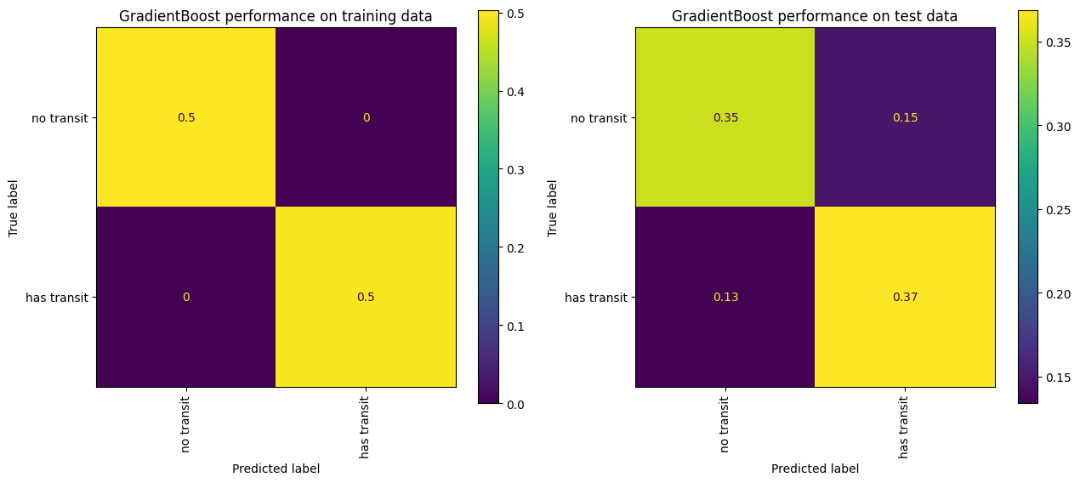
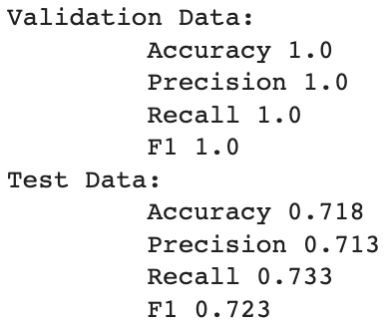
Algorithms: Gradient Boost
Results on Non-Engineered Features
Tuning hyperparameter max_depth and min_samples_leaf, learning_rate, max_features and n_estimators:
Best validation results for max_depth=10, max_features=sqrt, min_samples_leaf=5, learning_rate=0.1, n_estimators=150
Performance:

Slide 43

Algorithms: Gradient Boost
Results on Engineered Features
Tuning hyperparameter max_depth and min_samples_leaf, learning_rate, max_features and n_estimators:
Best validation results for max_depth=30, min_samples_leaf=5, max_features=sqrt learning_rate=0.15, n_estimators=150
Notes:
The best result for the Gradient Boost model was achieved on the phase-fold feature engineered data. We tuned the model based on 5 hyperparameter values - max_depth, min_samples_leaf, max_features, learning_rate and n_estimators. The graph below shows the train and validation accuracy achieved for each of the 216 permutations amongst the hyperparameters. The best validation accuracy of 78.3% was achieved with the hyperparameter values as show.
of max_depth=30, min_samples_leaf=5, max_features=sqrt learning_rate=0.15, n_estimators=150
The max depth, max_features and min samples leaf are to ensure that the model is not overfitted and these parameters help prune the tree. n_estimators is the maximum number of estimators at which boosting is terminated and the learning rate is the shrinkage factor of the output from each tree. The dataset was split into a train/test ratio of 80/20 and k-fold cross validation with k=10 was performed on the training data.

Slide 44


Algorithms: Gradient Boost
Results on Engineered Features
Tuning hyperparameter max_depth and min_samples_leaf, learning_rate, max_features and n_estimators:
Best validation results for max_depth=30, min_samples_leaf=5, max_features=sqrt learning_rate=0.15, n_estimators=150
Performance:
Notes:
Based on the hyperparameters, we got a test accuracy of 77% with a F1 score of 77%.
Based on the hyperparameters identified in the training step, an test accuracy of 77% was achieved. The confusion matrix along with the other performance metrics for both training/validation and test are shown below. The model provided a good trade-off between precision and recall with a f1-score of 0.77 on the test data.

Slide 45
Deep Learning
Neural Network = web of nodes (“neurons”) that learn how to weight various learned features of an input dataset to produce the correct output.

Slide 46

Deep Learning
Neural Network = web of nodes (“neurons”) that learn how to weight various learned features of an input dataset to produce the correct output.
Arranged into layers
Image from Ognjanovski, 2019

Slide 47
Deep Learning
Neural Network = web of nodes (“neurons”) that learn how to weight various learned features of an input dataset to produce the correct output.
Arranged into layers
Number of nodes of each layer represent
number of “features” that layer contains.
Image from Ognjanovski, 2019

Slide 48
Deep Learning
Neural Network = web of nodes (“neurons”) that learn how to weight various learned features of an input dataset to produce the correct output.
Arranged into layers
Number of nodes of each layer represent
number of “features” that layer contains.
Nodes in given layer connected to some/all
in previous one through weights.
Image from Ognjanovski, 2019

Slide 49
Deep Learning
Neural Network = web of nodes (“neurons”) that learn how to weight various learned features of an input dataset to produce the correct output.
Arranged into layers
Number of nodes of each layer represent
number of “features” that layer contains.
Nodes in given layer connected to some/all
in previous one through weights.
Layers can also contain "bias" nodes that are
not connected to previous layers.
Image from Ognjanovski, 2019

Slide 50
Deep Learning
Neural Network = web of nodes (“neurons”) that learn how to weight various learned features of an input dataset to produce the correct output.
Arranged into layers
Number of nodes of each layer represent
number of “features” that layer contains.
Nodes in given layer connected to some/all
in previous one through weights.
Layers can also contain "bias" nodes that are
not connected to previous layers.
Different networks types use different layer types - “pass” data through the layers differently
Image from Ognjanovski, 2019

Slide 51
Deep Learning
Neural Network = web of nodes (“neurons”) that learn how to weight various learned features of an input dataset to produce the correct output.
Arranged into layers
Number of nodes of each layer represent
number of “features” that layer contains.
Nodes in given layer connected to some/all
in previous one through weights.
Layers can also contain "bias" nodes that are
not connected to previous layers.
Different networks types use different layer types - “pass” data through the layers differently
End with set of predicted class probabilities; label observation with most probable class.
Image from Ognjanovski, 2019

Slide 52
Deep Learning - training a network
Cost function, C, quantifies difference between predictions and true labels.

Slide 53
Deep Learning - training a network
Cost function, C, quantifies difference between predictions and true labels.
Train using backpropagation

Slide 54

Deep Learning - training a network
Cost function, C, quantifies difference between predictions and true labels.
Train using backpropagation
Image source: Analytics Vidhya

Slide 55
Deep Learning - training a network
Cost function, C, quantifies difference between predictions and true labels.
Train using backpropagation
Adjust weights, biases to minimize C.
Process called “gradient descent”
Image source: Analytics Vidhya

Slide 56

Deep Learning - training a network
Cost function, C, quantifies difference between predictions and true labels.
Train using backpropagation
Adjust weights, biases to minimize C.
Process called “gradient descent”
Use chain rule to express how C depends on weights, biases

Slide 57

Deep Learning - training a network
Cost function, C, quantifies difference between predictions and true labels.
Train using backpropagation
Adjust weights, biases to minimize C.
Process called “gradient descent”
Use chain rule to express how C depends on weights, biases
Update each terms using derivatives
Learning rate. α, adjusts how fast model learns

Slide 58


Deep Learning - architectures used
First network type: linear
Layers connected via simple matrix multiplications.
Multiply by matrix of weights, θ.
Weights in θ_{i} represents connections between nodes in layer i−1 and in layer i.
Add a bias term, b and apply an activation function, g.
Image from Ognjanovski, 2019

Slide 59


Deep Learning - architectures used
Second network type: convolutional
Layers connected via convolutions
Convolve with kernel (matrix) of given size
Computed via cross-correlation
Add a bias term, b and apply an activation function, g.
Image from Ognjanovski, 2019

Slide 60
Deep Learning - architectures used
Linear networks
Trained on full lightcurves
Trained on phase-folded lightcurves
Single-channel convolutional network
Trained on phase-folded lightcurves
Double-channel convolutional networks
Trained on phase-folded lightcurves and phase-steps
LSTM network
Trained on phase-folded lightcurves

Slide 61
Deep Learning - architectures used
Linear networks
Trained on full lightcurves
Poor results - overall accuracy around 45% and recall 29%. F1 of 0.19.
Why? Perhaps there is too much noise in the curves themselves.
Thus, we train a second linear model on phase-folded lightcurves.

Slide 62
Deep Learning - architectures used
Linear networks
Trained on full lightcurves (~45% acc, ~29% recall, F1~0.19)
Trained on phase-folded lightcurves
Still low very low accuracy (~59%) and recall (~36%). F1 of 0.23. Why? Perhaps we need a model that can use the “spatial” (sequential) information better.

Slide 63
Deep Learning - architectures used
Linear networks
Trained on full lightcurves (~45% acc, ~29% recall, F1~0.19)
Trained on phase-folded lightcurves (~59% acc, ~36% recall, F1 ~0.23)
Single-channel convolutional network
Trained on phase-folded lightcurves
Similarly poor accuracy (~57%), slight increase in recall ~54%, F1 of 0.28.
Perhaps overall accuracy can be improved by including time-step information.

Slide 64
Deep Learning - architectures used
Linear networks
Trained on full lightcurves (~45% acc, ~29% recall, F1~0.19)
Trained on phase-folded lightcurves (~59% acc, ~36% recall, F1 ~0.23)
Single-channel convolutional network
Trained on phase-folded lightcurves (~57% acc, ~54% recall, F1~0.28)
Double-channel convolutional networks
Trained on phase-folded lightcurves and phase-steps
Significantly better (still poor, ~62%) accuracy, excellent recall (~99%). F1 of ~0.36
Could this be improved further by other models?

Slide 65
Deep Learning - architectures used
Linear networks
Trained on full lightcurves (~45% acc, ~29% recall, F1~0.19)
Trained on phase-folded lightcurves (~59% acc, ~36% recall, F1 ~0.23)
Single-channel convolutional network
Trained on phase-folded lightcurves (~57% acc, ~54% recall, F1~0.28)
Double-channel convolutional networks
Trained on phase-folded curves and phase-steps (~62% acc, ~99% recall, F1~0.32)
LSTM (type of RNN) network
Trained on phase-folded lightcurves
Total accuracy way down to ~49%, but recall ~100%. F1 ~0.33.

Slide 66
Deep Learning - architectures used
Linear networks
Trained on full lightcurves (~45% acc, ~29% recall, F1~0.19)
Trained on phase-folded lightcurves (~59% acc, ~36% recall, F1 ~0.23)
Single-channel convolutional network
Trained on phase-folded lightcurves (~57% acc, ~54% recall, F1~0.28)
Double-channel convolutional networks
Trained on phase-folded curves and phase-steps (~62% acc, ~99% recall, F1~0.32)
LSTM (type of RNN) network
Trained on phase-folded lightcurves (~49% acc, ~100% recall, F1~0.33)

Slide 67
Deep Learning - overall thoughts
LSTM has the best F1 and recall
But super low accuracy likely means we are just predicting way to many transits
2-channel CNN has much better accuracy and still extremely high recall. Similar F1.
Appears to be the best NN model so far
All NN models do worse than simpler algorithms, so we turn back to those to select our best model.

Slide 68
Feature selection
Feature selection in refers to the process of selecting a subset of relevant and significant features (input variables) from the original set of features in a dataset. Of various methods of feature selection we tired out Recursive feature selection(RFE) and Filter Method particularly sklearn selectKBest.
Recursive feature selection(RFE): It is an iterative feature selection method that starts with all features and repeatedly removes the least important features based on a model's performance until a desired number of features is reached.
Since the number of features in our dataset was very large this method took too long to complete.
Filter Method: Filter methods pick up the intrinsic properties of the features measured via univariate statistics instead of cross-validation performance. They evaluate the relevance of features based on their individual characteristics, such as correlation with the target variable or statistical tests like ANOVA or chi-square tests.
We experimented with the SelectKBest API to reduce the number of features. We used the default scrore_function of f_classif. After trying different number of features the overall performance of the models did not improve.
Notes:
Feature selection in machine learning refers to the process of selecting a subset of relevant and significant features (input variables) from the original set of features in a dataset. The goal of feature selection is to improve model performance, reduce overfitting, and enhance interpretability by focusing on the most informative and discriminative features while discarding irrelevant or redundant ones. Feature selection is particularly important when dealing with high-dimensional datasets, where the number of features is large compared to the number of samples. Of various methods of feature selection we tired out Recursive feature selection(RFE) and Filter Method particularly sklearn selectKBest.
Recursive feature selection(RFE): It is an iterative feature selection method that starts with all features and repeatedly removes the least important features based on a model's performance until a desired number of features is reached. Since the number of features in our dataset was very large this method took too long to complete.
Filter Method: Filter methods pick up the intrinsic properties of the features measured via univariate statistics instead of cross-validation performance. They evaluate the relevance of features based on their individual characteristics, such as correlation with the target variable or statistical tests like ANOVA or chi-square tests.
We experimented with the SelectKBest API to reduce the number of features. We used the default scrore_function of f_classif. For each feature, the f_classif method calculates the ANOVA F-statistic, which measures the variation between the class labels (target variable) for that feature. After trying different number of features the overall performance of the models did not improve. Hence, we did not include any feature selection for final model selection.

Slide 69
Best Model Performance: Gradient Boost Classifier
Can we do better than this?
It is likely that our limitation is the data itself.
Notes:
Based on the hyperparameters identified in the training step, an test accuracy of 77% was achieved. The confusion matrix along with the other performance metrics for both training/validation and test are shown below. The model provided a good trade-off between precision and recall with a f1-score of 0.77 on the test data which was the highest among all the models attempted.

Slide 70
Future Work
Classification of lightcurves is challenging
Difficult to extract the low signal-to-noise transits of small planets
Stellar variability can mimic periodic transit signals
Very high dimensional data
Future work could explore new classification methods better designed for time-series data:
AR(I)MA - Autoregressive (Integrated) Moving Average
Deep Learning
Convolutional Neural Networks
Feedforward Neural Networks
Or, explore new methods of feature engineering:
Fit transit models and extract transit parameters as features
Transform lightcurves using Dynamic Time Warping or Wavelet Analysis

Slide 71
Group Contributions
Initial data acquisition/exploration
Select dataset, create function for downloading and visualizing example observations → Anna
Create function to download and standardize all observations → Leah
Literature review of past works → Leah
Preprocessing
Stitching/detrending/smoothing observations, filling in missing values → Anna
Feature engineering
Phase-folding → Anna
Exploration of Recursive Feature Selection and SelectKBest → Ashutosh
Implementation/analysis of ML algorithms
Standard algorithms: KNN, RF, and LR → Anna
Standard algorithms: SVM, AdaBoost, and Gradient Boost → Ashutosh
Deep Learning: Linear Neural Network → Leah
Deep Learning: Convolutional Neural Network → Leah
Project administration
Proposal write-up → Anna, Leah, Ashutosh
Checkpoint write-up → Anna, Leah
Final presentation write-up → Anna, Leah, Ashutosh
Final slides → Anna, Leah, Ashutosh, Andrew

Slide 72
Works Cited
S. Aigrain and F. Favata. Bayesian detection of planetary transits. A modified version of the Gregory-Loredo method for Bayesian periodic signal detection. , 395:625–636, Nov. 2002. doi: 10.1051/0004-6361:20021290.
M. Ansdell, et al. Scientific domain knowledge improves exoplanet transit classification with deep learning. The Astrophysical Journal, 869(1):L7, dec 2018. doi: 10.3847/2041-8213/aaf23b.
D. J. Armstrong, et al. machine learning classification of variable stars and eclipsing binaries in k2 fields 0–4. Monthly Notices of the Royal
Astronomical Society , 456(2):2260–2272, dec 2015. doi: 10.1093/mnras/stv2836.
L. F. A. Arnold. Transit Light-Curve Signatures of Artificial Objects. , 627(1):534–539, July 2005. Doi: 10.1086/430437.
N. M. Batalha, et al. SELECTION, PRIORITIZATION, AND CHARACTERISTICS OF iKEPLER/i TARGET STARS. The Astrophysical Journal , 713(2):L109–L114, mar 2010. doi: 10.1088/2041-8205/713/2/l109. J. Catanzarite. Autovetter Planet Candidate Catalog for Q1-Q17 Data Release 24.
Astronomy and Astro-physics, July 2015.
D. Charbonneau, T. M. Brown, D. W. Latham, and M. Mayor. Detection of Planetary Transits Across a Sun-like Star. , 529(1):L45–L48, Jan. 2000. doi: 10.1086/312457
P. Chintarungruangchai and I.-G. Jiang. Detecting exoplanet transits through machine-learning techniques with convolutional neural networks. Publications of the Astronomical Society of the Pacific, 131(1000): 064502, may 2019. doi: 10.1088/1538-3873/ab13d3.
J. L. Coughlin, et al.. Planetary Candidates Observed by Kepler. VII. The First Fully Uniform Catalog Based on the Entire 48-month Data Set (Q1-Q17 DR24).
, 224(1):12, May 2016. doi: 10.3847/0067-0049/224/1/12.
S. Grziwa, M. P ̈atzold, and L. Carone. The needle in the haystack: searching for transiting extrasolar planets in CoRoT stellar light curves. , 420(2):1045–1052, Feb. 2012. doi: 10.1111/j.1365-2966.2011.19970.x.
J. M. Jenkins, et. al.Overview of the Kepler Science Processing Pipeline. , 713(2):L87–L91, Apr. 2010. doi: 10.1088/2041-
8205/713/2/L87.
D. M. Kipping and A. Teachey. A cloaking device for transiting planets. , 459:1233–1241, June 2016. Doi: 10.1093/mnras/stw672.
G. Kov ́acs, S. Zucker, and T. Mazeh. A box-fitting algorithm in the search for periodic transits. , 391: 369–377, Aug. 2002. doi: 10.1051/0004-6361:20020802.

Slide 73
D. M. Kipping and A. Teachey. A cloaking device for transiting planets. , 459:1233–1241, June 2016. Doi: 10.1093/mnras/stw672.
G. Kov ́acs, S. Zucker, and T. Mazeh. A box-fitting algorithm in the search for periodic transits. , 391: 369–377, Aug. 2002. doi: 10.1051/0004-6361:20020802.
A. Malik, B. P. Moster, and C. Obermeier. Exoplanet detection using machine learning. Monthly Notices of the Royal Astronomical Society, dec 2021. doi: 10.1093/mnras/stab3692.
S. D. McCauliff, et. al. AUTOMATIC CLASSIFICATION OFiKEPLER/iPLANETARY TRANSIT CANDIDATES. The Astrophysical Journal, 806(1):6, jun 2015. doi: 10.1088/0004-637x/806/1/6.
Ognjanovski, G. (2019, January 14). Everything you need to know about Neural Networks and Backpropagation — Machine Learning Easy and Fun. Towards Data Science. Retrieved July 24, 2023, from https://towardsdatascience.com/everything-you-need-to-know-about-neural-networks-and-backpropagation-machine-learning-made-easy-e5285bc2be3a
K. A. Pearson, L. Palafox, and C. A. Griffith. Searching for exoplanets using artificial intelligence. , 474(1): 478–491, Feb. 2018. doi: 10.1093/mnras/stx2761.
G. R. Ricker, et al. Transiting Exoplanet Survey Satellite (TESS). Journal of Astronomical Telescopes, Instruments, and Systems, 1:014003, Jan. 2015. Doi: 10.1117/1.JATIS.1.1.014003.
N. Schanche, et al. Machine-learning approaches to exoplanet transit detection and candidate validation in wide-field ground-based surveys. Monthly Notices of the Royal Astronomical Society, 483(4): 5534–5547, nov 2018. doi: 10.1093/mnras/sty3146.
C. J. Shallue and A. Vanderburg. Identifying exoplanets with deep learning: A five-planet resonant chain around kepler-80 and an eighth planet around kepler-90. The Astronomical Journal, 155(2):94, jan 2018. doi: 10.3847/1538-3881/aa9e09.
M. C. Stumpe, J. C. Smith, J. H. Catanzarite, J. E. Van Cleve, J. M. Jenkins, J. D. Twicken, and F. R.
Girouard. Multiscale Systematic Error Correction via Wavelet-Based Bandsplitting in Kepler Data. , 126 (935):100, Jan. 2014. doi: 10.1086/674989.
S. Thompson, D. Fraquelli, J. E. van Cleve, and D. A. Caldwell. Kepler: A search for terrestrial planets (kepler archive manual). may 2016.
A. Wolszczan and D. A. Frail. A planetary system around the millisecond pulsar PSR1257 + 12. , 355 (6356):145–147, Jan. 1992. doi: 10.1038/355145a0.
L. Yu, et al. Identifying exoplanets with deep learning. III. automated triage and vetting of iTESS/i candidates. The Astronomical Journal , 158(1):25, jun 2019. doi: 10.3847/1538-3881/ab21d6.
S. Zucker and R. Giryes. Shallow Transits—Deep Learning. I. Feasibility Study of Deep Learning to Detect Periodic Transits of Exoplanets. , 155(4):147, Apr. 2018. doi: 10.3847/1538-3881/aaae05.

